Slide 1
IBM University Engagement Project Submission
“Exploring the Power of Agentic AI with IBM Granite and IBM Bob”

Slide 2

Project Tile – Research Agent
Domain of Project – Healthcare
Student Name | Recent Passport Photo | Email ID | Mobile number [WhatsApp]
Ayush Bangwal |  | ayushbangwal@2005@gmail.com | 9259387553

Slide 3
Problem Statement -
Problem Statement : Research Agent
The Challenge
A Research Agent is an AI system designed to assist with academic and scientific research tasks. It can autonomously search for literature, summarize papers, and organize references. Using natural language processing, it understands research questions and retrieves relevant information. The agent can generate reports, suggest hypotheses, and even draft sections of research papers. It saves time by automating repetitive tasks like citation management and data extraction. Research Agents enhance efficiency, accuracy, and innovation in both academic and industrial R&D.
The Objective
Build an AI-powered Research Agent that helps students, researchers, and professionals with efficient academic research and knowledge discovery. The solution should:
Personalized Research Assistance – Understand research topics and provide relevant information.
Research Paper RAG Retrieval – Retrieve relevant research papers and reliable academic sources.
Paper Summarization – Summarize research papers, methodologies, results, and findings.
Research Gap Detection – Identify gaps, limitations, and unexplored areas in existing research.
Citation Management – Organize references and generate citations in standard formats.
Research Idea Generation – Suggest research questions, hypotheses, and potential solutions.
Multi-Agent System –
Research Retrieval Agent – Fetches relevant research papers.
Paper Analysis Agent – Analyzes and summarizes papers.
Research Gap Agent – Identifies research gaps.
Citation Agent – Manages references and citations.
Report Generation Agent – Generates structured research reports.

Slide 4
Proposed Solution -
Proposed Solution: AI-Powered Research Agent
The proposed solution is a multi-agent AI-powered Research Agent built using IBM Bob, IBM watsonx.ai, and Granite Models to assist students and researchers with literature review, paper analysis, and research report generation.
At its core, the solution uses a Retrieval-Augmented Generation (RAG) pipeline to retrieve relevant research papers from reliable academic sources. The papers are embedded and stored in a vector database, allowing the system to retrieve and summarize relevant research information using Granite models.
The system consists of five key agents:
Research Query Agent – Understands the research question and generates relevant search queries.
Literature Retrieval Agent – Retrieves relevant research papers and academic information using RAG.
Paper Analysis Agent – Analyzes papers and extracts objectives, methodology, results, limitations, and findings.
Research Gap Agent – Compares existing research and identifies research gaps, limitations, and unexplored areas.
Report Generation Agent – Generates literature reviews, research ideas, citations, and structured research reports.
The solution includes a user-friendly dashboard built with Streamlit or React that displays retrieved papers, key findings, research trends, research gaps, and generated reports.
IBM Bob is used to build and orchestrate the agent workflow, while watsonx.ai supports model deployment, embeddings, and AI governance. Granite models power reasoning, summarization, paper analysis, and report generation.
Overall, this solution provides an end-to-end intelligent research assistant that reduces the time required for literature review and helps researchers discover relevant information, research gaps, and new research directions.

Slide 5
Technology Used
IBM watsonx Orchestrate – For designing and orchestrating multi-agent research workflows visually.
IBM Granite Model – For example, ibm-granite-3-2-8b – For natural language understanding, reasoning, paper summarization, and research analysis.
IBM Cloud – Provides the infrastructure to build, deploy, and scale the Research Agent in a reliable, secure, and scalable environment.
RAG (Retrieval-Augmented Generation) – To retrieve real research papers and academic information first, then generate accurate and context-based responses.
IBM watsonx.ai – For model deployment, embeddings, AI development, and governance.
Vector Database (FAISS/Chroma) – For storing and retrieving research paper embeddings and relevant document chunks efficiently.

Slide 6
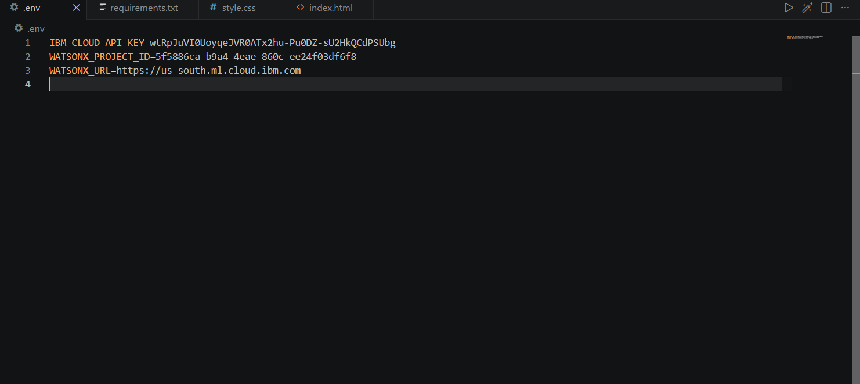
Required Files created using IBM bob -
App.py
Requirements.txt
Style.css
.env
Index.html

Slide 7
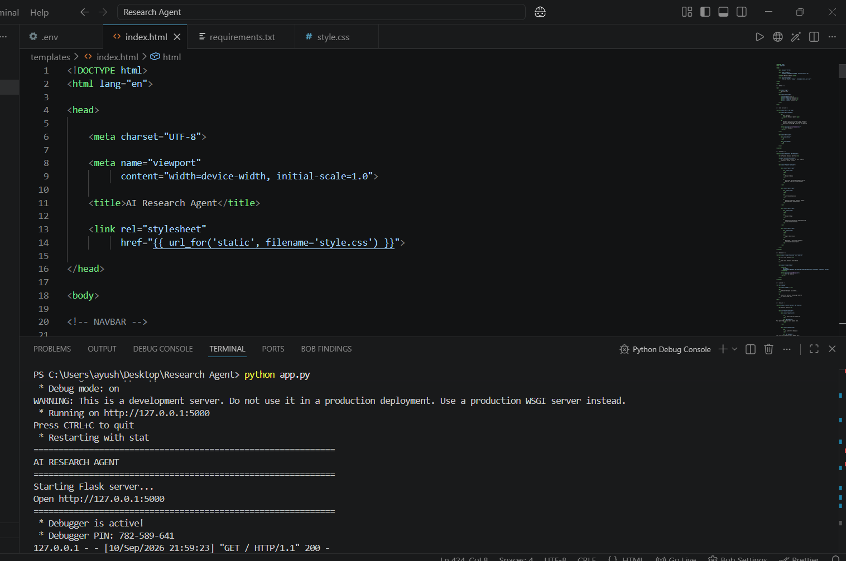
IBM Bob Screenshots:

Slide 8
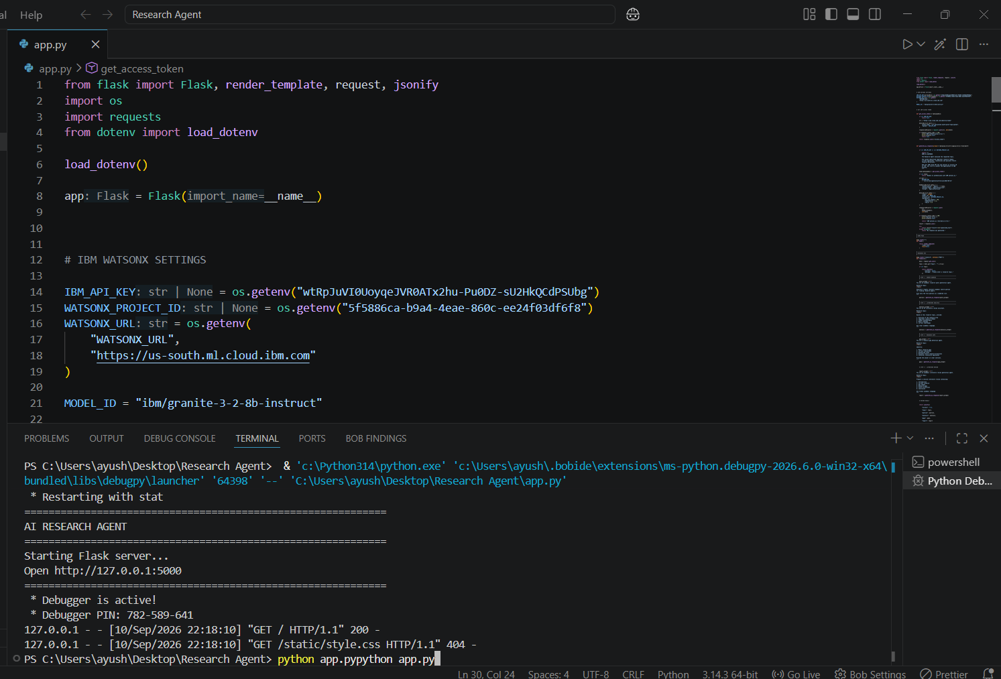

Slide 9
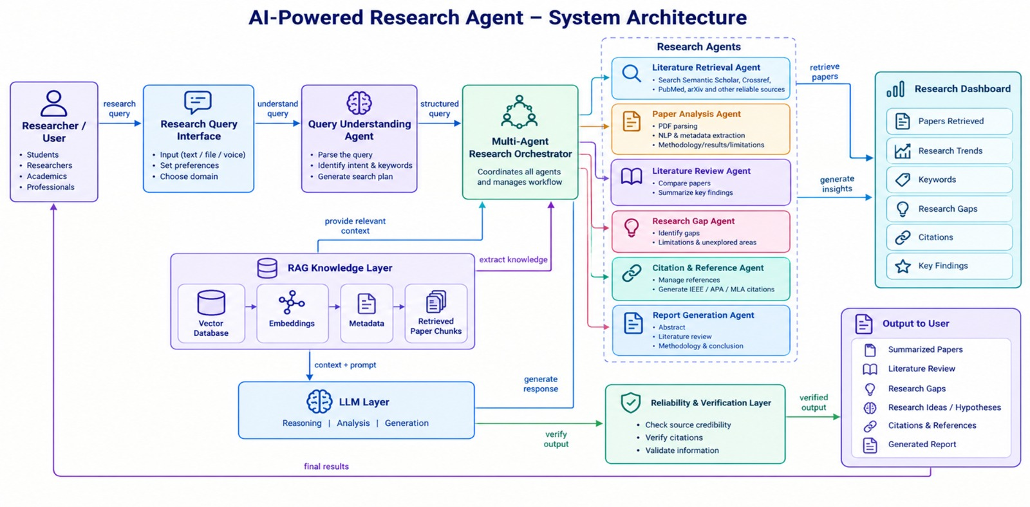
Architecture blueprint for IBM bob:

Slide 10

Role of Agentic AI in the solution
Role of Agentic AI in Research Agent
Agentic AI enables the Research Agent to function as an intelligent, autonomous system rather than a simple chatbot. Using IBM watsonx.ai and IBM Granite models, it coordinates multiple specialized agents to support academic and scientific research.
Each agent performs a specific role—such as understanding research queries, retrieving research papers, analyzing literature, identifying research gaps, and generating research reports—while working collaboratively. This multi-agent approach ensures efficient research task execution and relevant results.
Agentic AI also provides context awareness, understanding the user's research topic and requirements to retrieve and analyze relevant information. It supports real-time adaptation, refining the research process based on user queries and feedback.
Additionally, the agents communicate with each other, enabling better literature analysis, research-gap identification, and decision-making.
Overall, Agentic AI makes the system intelligent, efficient, research-focused, and goal-driven, acting like a smart digital research assistant that helps users discover knowledge and develop new research ideas.

Slide 11
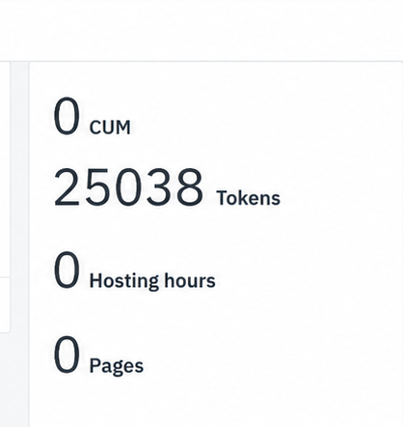
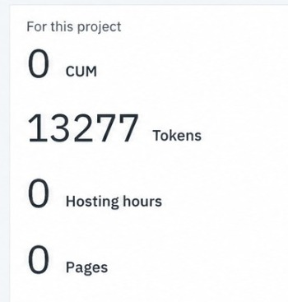
Token Usage
11,761 token are used
Before Prompt
After the Prompt
·
·
·

Slide 12
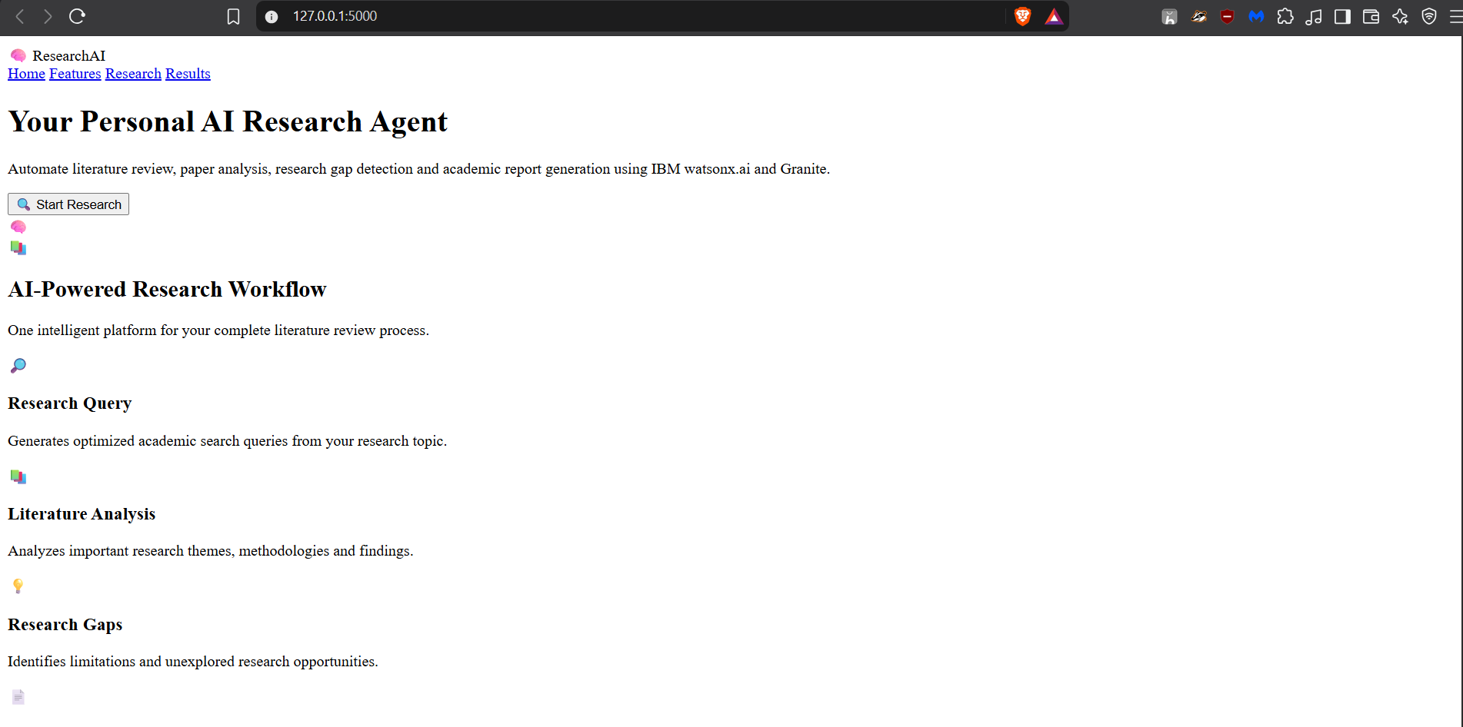
Project Output Screenshot
Please put IBM Bob output screenshots with 2-3 prompts.
You can take 2-3 more slides for each screenshot
·
·
·

Slide 13
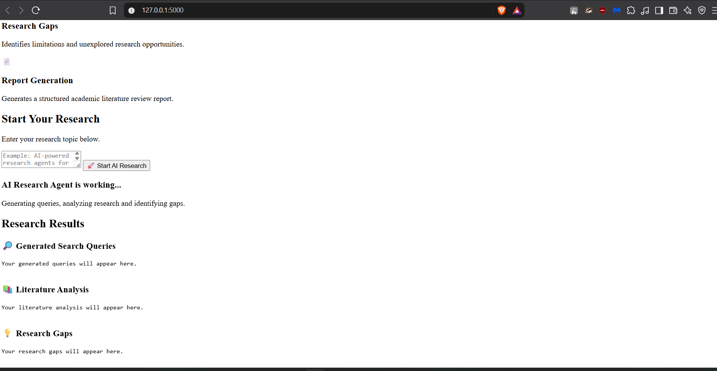
Project Output Screenshot
·
·
·

Slide 14
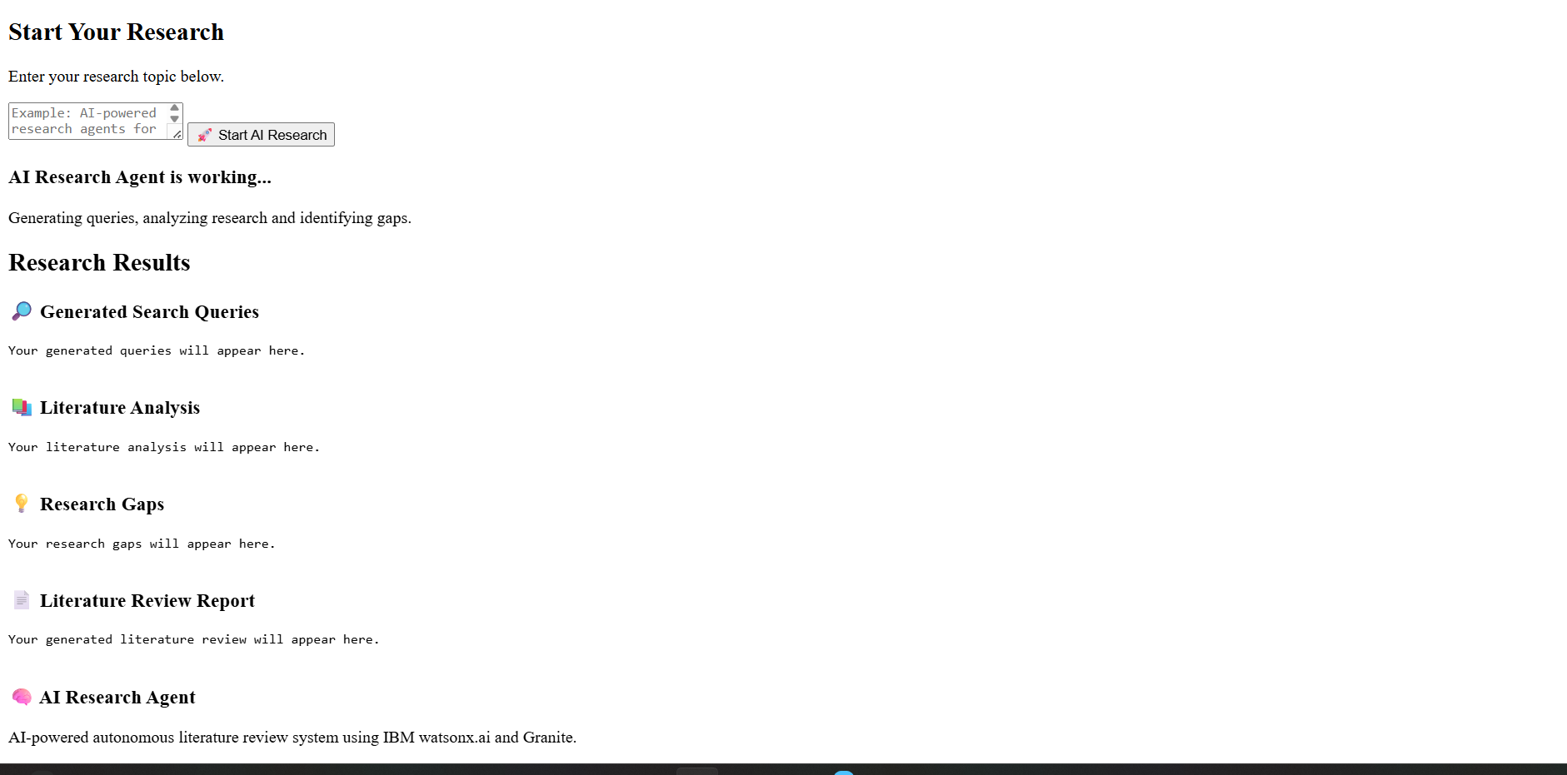
Project Output Screenshot

Slide 15
Novelty and Uniqueness
The proposed Research Agent stands out by combining Agentic AI, RAG, and automated research analysis into a single intelligent system.
Multi-Agent Intelligence – Multiple specialized agents collaborate to understand queries, retrieve literature, analyze papers, identify research gaps, and generate reports.
RAG-Based Accuracy – Retrieves relevant information from research papers before generating responses, improving the relevance and reliability of research insights.
Intelligent Research Analysis – Automatically extracts key information such as objectives, methodologies, results, and limitations from research papers.
Research Gap Identification – Compares existing literature to identify unexplored areas, limitations, and potential research opportunities.
Context-Aware Research – Understands the user's research topic and requirements to provide relevant literature and focused insights.
Automated Report Generation – Generates structured literature reviews, research summaries, research ideas, and reports.
Real-Time Research Assistance – Continuously refines results based on user queries and feedback.
Scalable & Enterprise-Ready – Built using IBM watsonx.ai and IBM Granite models, supporting reliable AI-based research workflows.
This makes the solution a smart, adaptive, and proactive digital research assistant, rather than just a conventional research search or chatbot tool.

Slide 16
Git Hub Link
· Please create public github repository (Enable Add README button while creating repository) with format –
Please test and Paste the working Github URL –
Make sure you have Uploaded following three files into your github repository
1) All Agent relevant files of IBM Cloud , 2) yourproblemstatement.pdf file 3) your projectpresntation.pptx file 4)any other files
Github link- https://github.com/Ayushbangwal/Research-Agent
·
·
·

Slide 17
Future Scope
Integration with Academic Databases & Research Platforms –
The system can be integrated with academic databases and research platforms to access a larger collection of research papers. This will enable the Research Agent to provide more comprehensive and up-to-date literature analysis.
2. AI-Powered Voice Assistant & Multilingual Support –
Enhancing the system with voice interaction and support for multiple languages will improve accessibility. Users can ask research questions naturally in their preferred language, making the solution more inclusive and user-friendly.
3. Advanced Research Gap & Trend Analysis –
The system can be extended to analyze large volumes of research papers to identify emerging research trends, unexplored areas, and potential future research directions.
4. Automated Citation & Reference Management –
Future versions can automatically generate and manage citations in formats such as IEEE, APA, and MLA, reducing the effort required for academic writing.
.
·
·
·

Slide 18
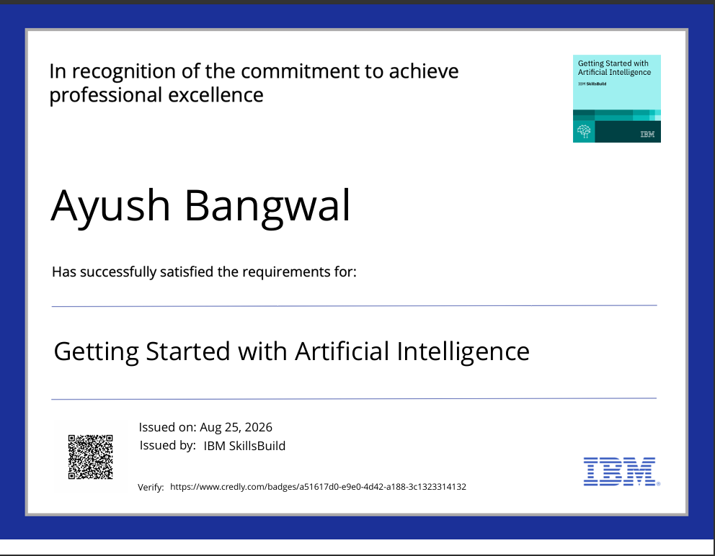
Certificates Earned:
Please add your credly certificate(Getting Started with Artificial Intelligence)

Slide 19
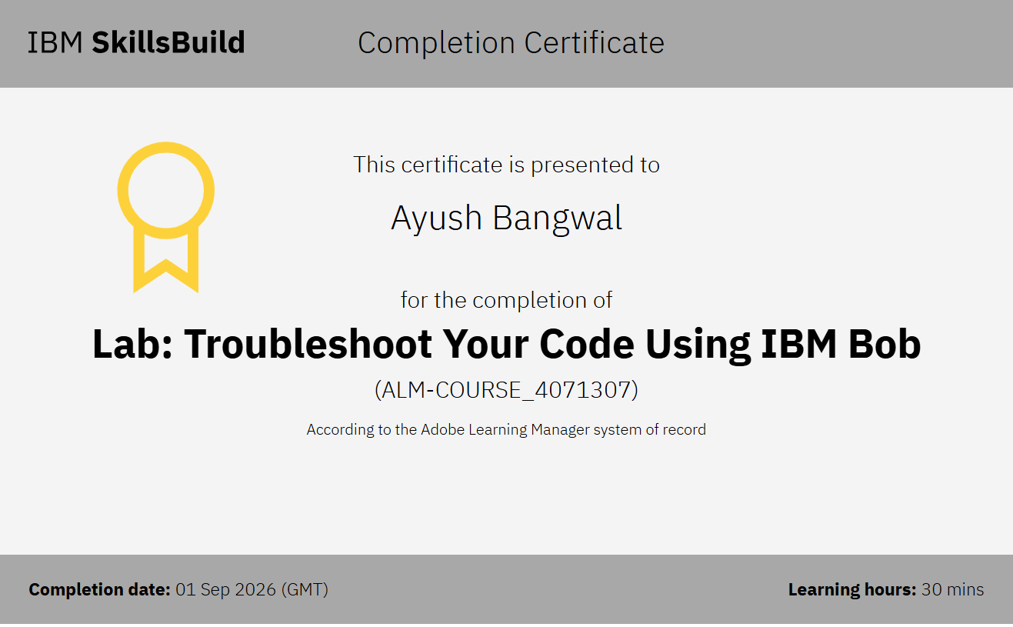
Certificates Earned:​
Add your IBM BOB Certificate

Slide 20


